Slide 1

Organic Producer Group Certification
Presented by Beth Rota, QCS Organic Program Director
October 18, 2023

Slide 2


The lingo
Old: Grower Group
New: Producer Group (NOP) = Group of operators (EU)

Slide 3

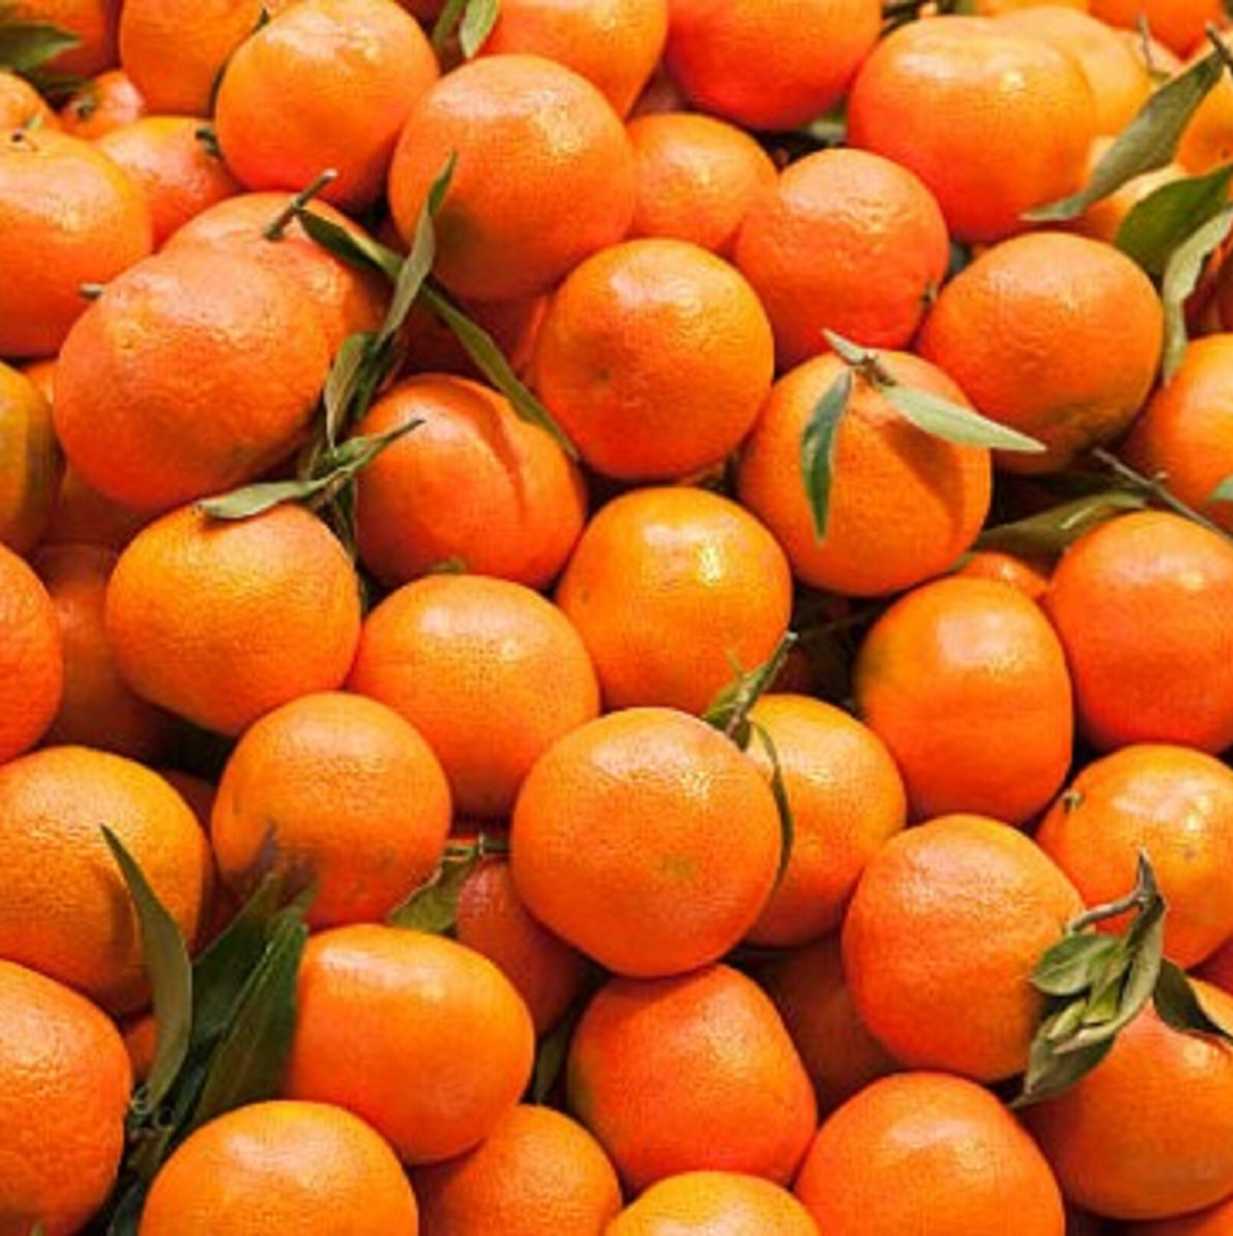
7 CFR 205.2 Producer group operation
A producer, organized as a person, consisting of producer group members and production units in geographic proximity governed by an internal control system under one organic system plan and certification.

Slide 4


General requirements for organic certification
7 CFR 205.400
Regulation (EU) 2018/848, Article 36

Slide 5
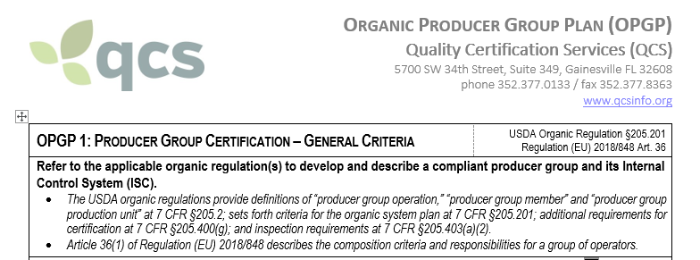
Producer Group Member Plan

Slide 6
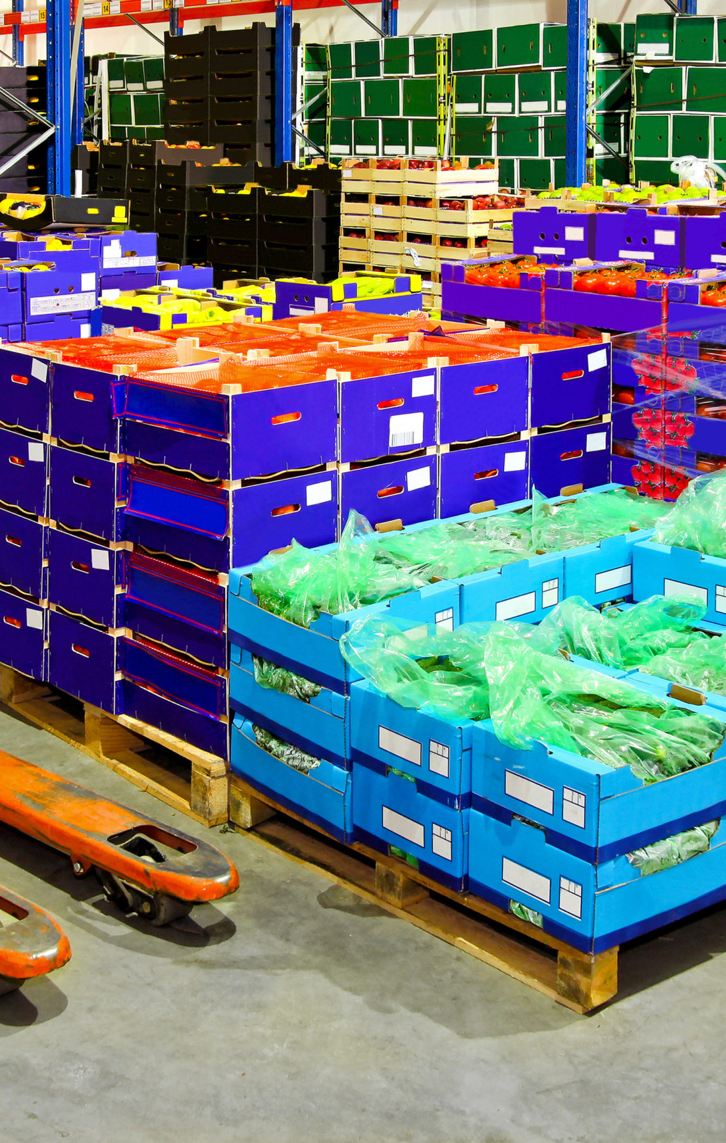
Producer group structure and requirements
Legal entity
Centralized processing, distribution, and marketing
Internal control system (ICS) to oversee compliance of the group and its members
Geographic proximity
Shared practices, resources, and recordkeeping
Only members can market organic products through the group
Members cannot market organic products outside of the group without individual certification
Membership limited to one group for same product(s)
Annual internal compliance inspection of each member
Annual review by certifier

Slide 7
EU size limitations
≤ 2,000 members
Entire holding of each member ≤ five hectares;
OR
Individual certification too costly:
  >2% of annual organic sales which must be ≤ €25,000
  ≤ €15,000

Slide 8
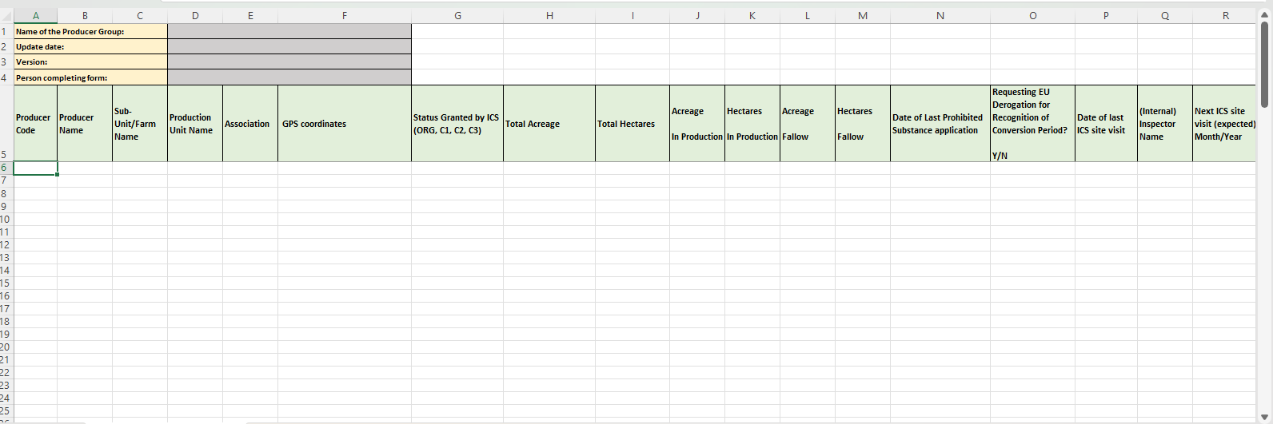
Member List

Slide 9

Internal Control System (ICS) Requirements

Slide 10
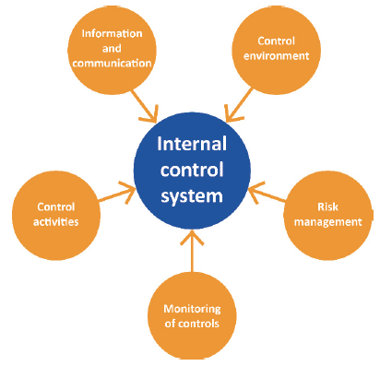
7 CFR 205.2 Internal control system (ICS)
An internal quality management system that establishes and governs the review, monitoring, training, and inspection of the producer group operation, and the procurement and distribution of shared production and handling inputs and resources, to maintain compliance with the USDA organic regulations.

Slide 11
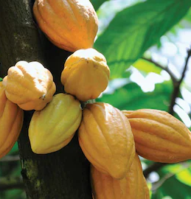
Internal Control System
Structure, roles and responsibilities
  EU requires separate ICS manager and inspectors
Geographic proximity criteria for members and production units
Production units and locations
Measures to prevent conflicts of interest and retribution
Acceptance of new members/activities, initial inspection and compliance determination

Slide 12
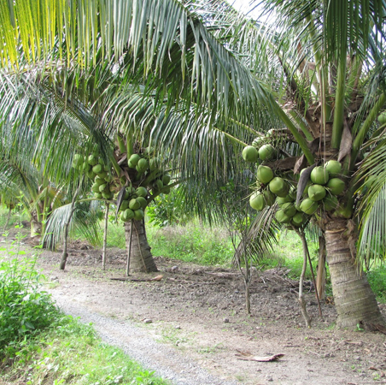
Internal Control System
Annual inspection procedure
Inspector training and assessment
Training of members
Control of documents and records
Measures and follow-up in case of noncompliance
Internal traceability

Slide 13
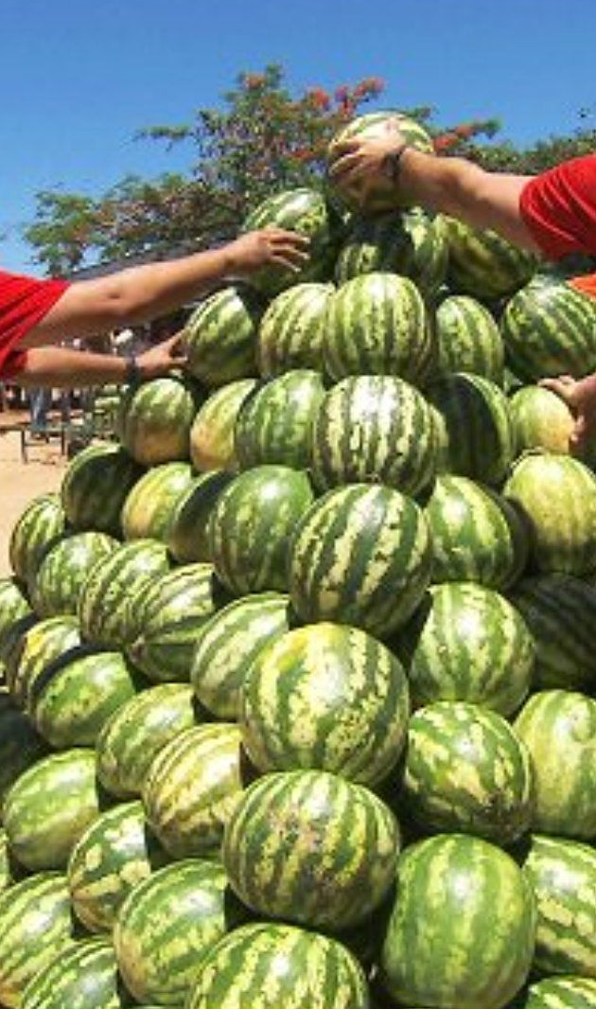
ICS manager responsibilities
Verify member eligibility
Maintain membership agreement
Manage recordkeeping procedure
Maintain membership list, approve members, implement measures
Assign and schedule internal inspections
Communicate with certifier
Verify annual conflict of interest statement from internal inspectors
Train and assess inspectors annually

Slide 14

Notification of internal findings
Suspicion of major and critical non-compliance;
Suspension or withdrawal of a member or a production unit or premises
Any prohibition of the placing on the market of a product as organic or in-conversion, including the name of the member or members concerned, the relevant quantities and lot identification (EU)

Slide 15
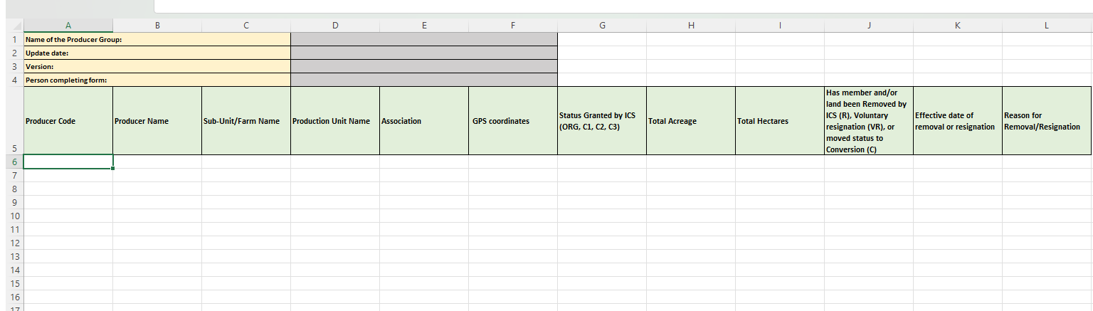
Removed member list

Slide 16
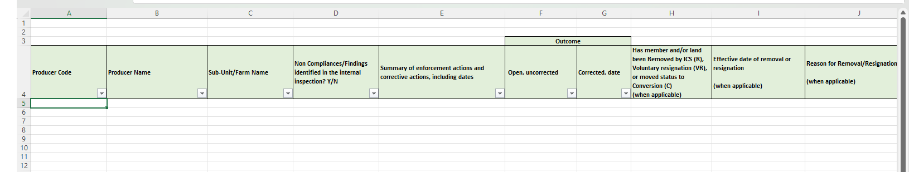
Enforcement Activities

Slide 17

On-Site Inspections/
Official controls

Slide 18
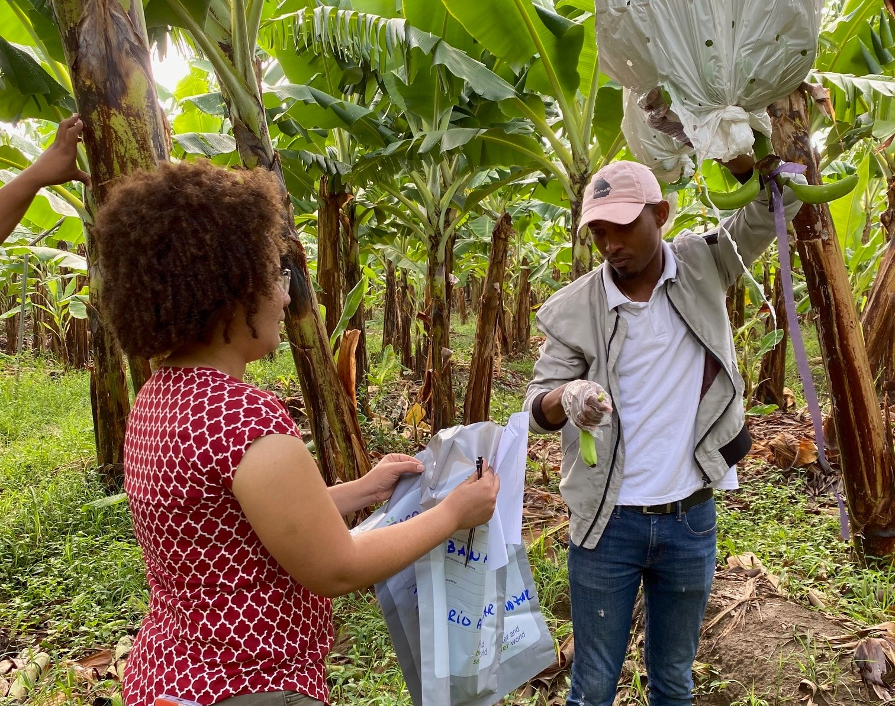
On-site inspections
Assess the set-up and functioning of the internal control system
Review internal inspections conducted by the ICS – compare results
Witness internal inspectors in action

Slide 19
Meaningful inspection of members
≥10 member inspections for all groups with 10 or more members
All high-risk members
EU
USDA
# members x 1.4 x SQRT
Risk based:
Low risk = 5%
Medium risk = 6%
High risk = 7%

Slide 20
250 Member Producer Group
EU Low Risk (5%) | 13
EU Medium Risk (6%) | 15
EU High Risk (7%) | 18
NOP 1.4*SQRT | 23

Slide 21
1,000 Member Producer Group
EU Low Risk (5%) | 50
EU Medium Risk (6%) | 60
EU High Risk (7%) | 70
NOP 1.4*SQRT | 45

Slide 22
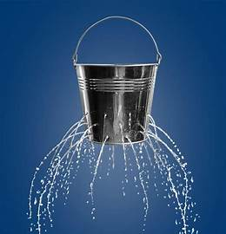
Deficiencies in the set-up or functioning of the ICS
Failure to detect non-compliances through internal oversight
Failing to notify QCS and updating member list when members are suspended or withdrawn
Representing products as organic from suspended/withdrawn members or product blocked by ICS
Adding new members or without following the internal approval procedure
Not carrying out the annual physical inspection of each member
Serious deviations in findings between internal inspection and QCS inspections
Serious deficiencies in implementing measures or follow-up for non-compliance identified by the ICS or QCS
Inadequate number or competencies of ICS inspectors

Slide 23
5700 SW 34th Street, Suite 349
Gainesville FL 32608 phone 352.377.0133 / fax 352.377.8363 www.qcsinfo.org

