Slide 1
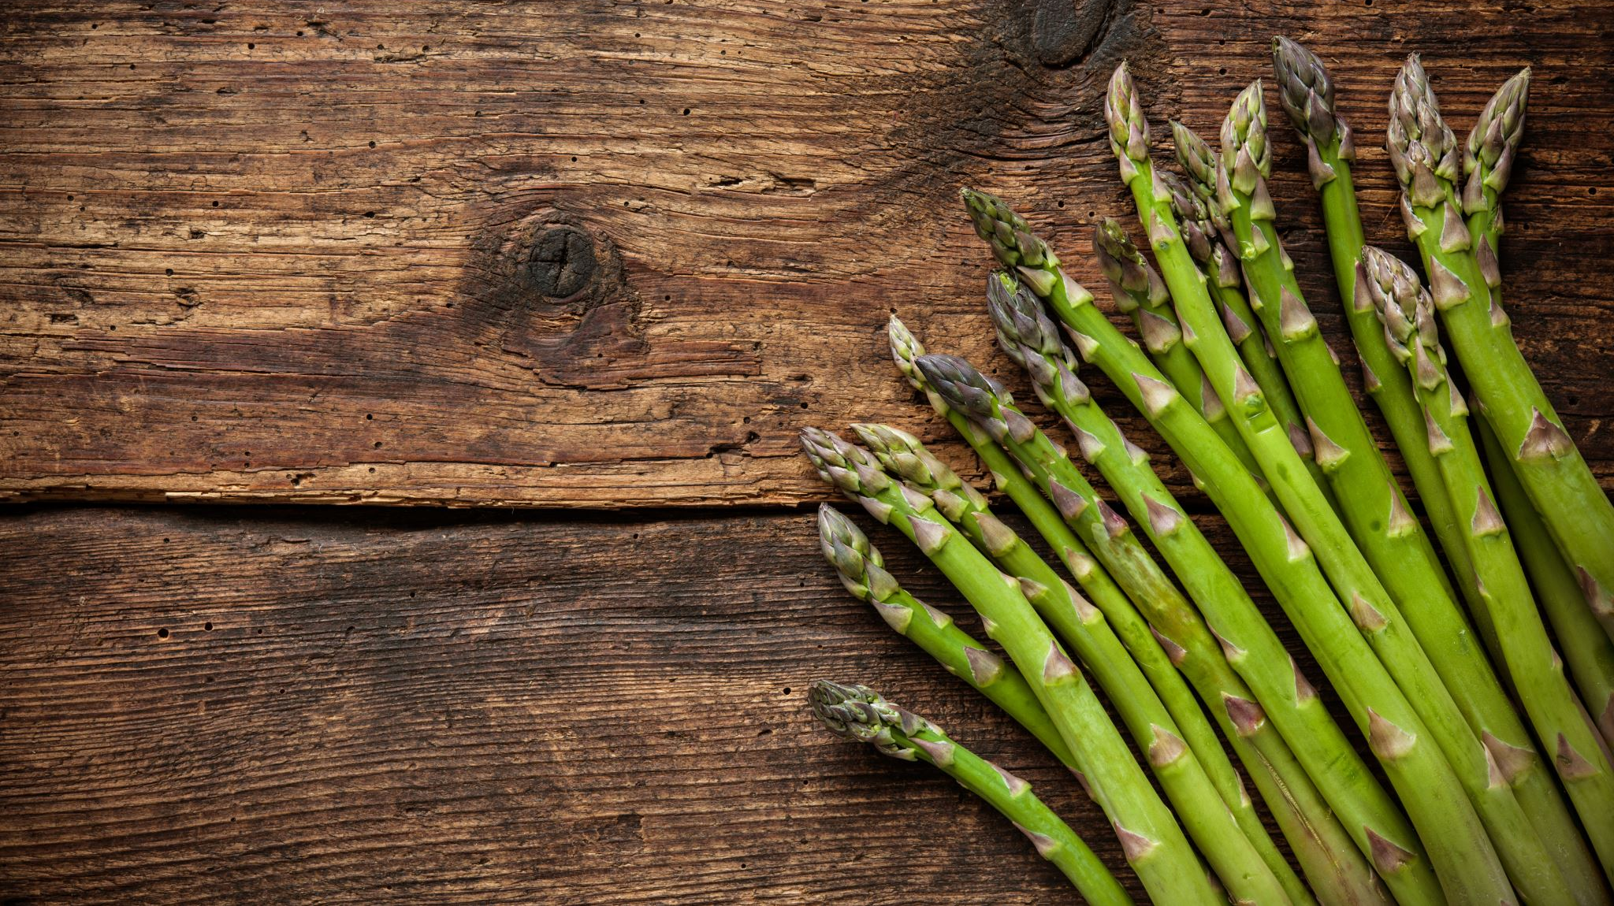
The basics of composting
Leslie Touzeau
Material Review Manager
Quality Certification Services

Slide 2
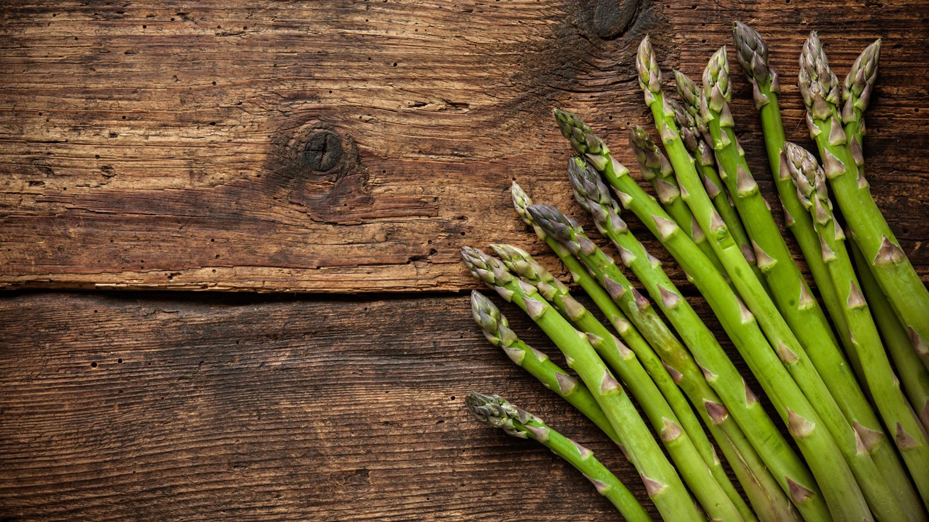
Agenda
What is composting?
Variables for controlling the composting process
Composting methods
Organic regulations for compost

Slide 3
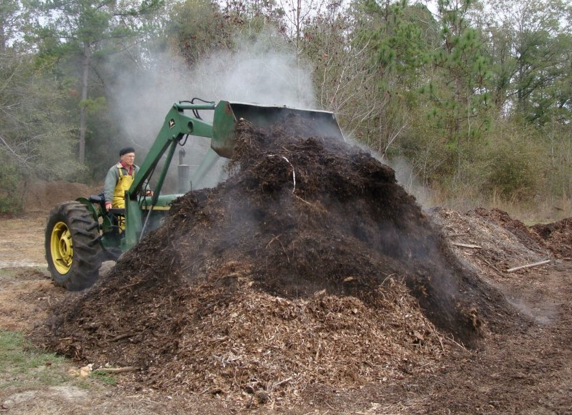
Why Compost?
Turn waste products into an easily handled material
  Reduce weight, moisture content and odor of manure
Create a valuable commodity
  Soil conditioner
    Adds organic matter
    Improves soil structure
    Reduces fertilizer requirements
    Reduces soil erosion
Notes:
So why compost? Why am I talking about composting today? Compost is a very common input we see on organic operations, and it is valued because it improves soil fertility, increases microbial activity, improves soil structure, and improves the soils ability to hold onto essential nutrients, all by reusing on-farm available feedstocks. This is important because organic agriculture really focuses on limiting off-farm inputs as much as possible, so compost when made on-farm is a great way to improve soils while not relying on off-farm fertilizers or synthetic soil amendments. It’s a very cost-effective and beneficial material for crop and livestock operations, but there is a proper way to compost that greatly reduces the risk of pathogens. MY hope is this information will be helpful to inspectors and reviewers when evaluating composts made on-farm or reviewing composts as commercial inputs.

Slide 4
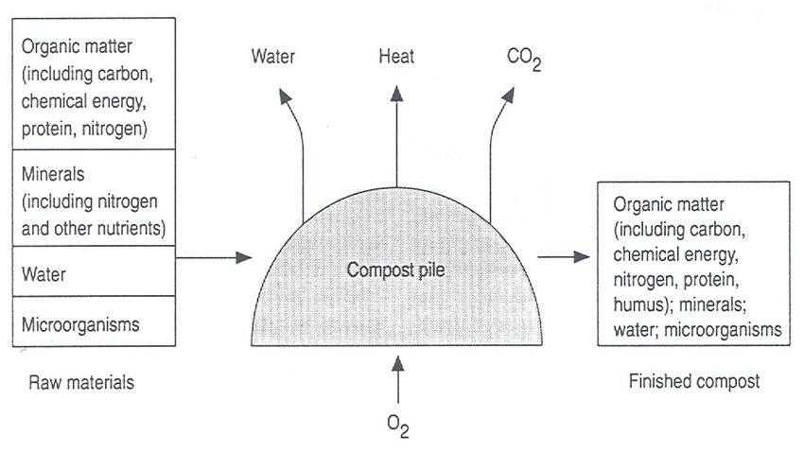
What is Composting?
Aerobic (oxygen-requiring) decomposition of organic materials by microorganisms under controlled conditions
Notes:
Microorganisms consume oxygen while feeding on organic matter. This generates heat and releases CO2 and water vapor into the air. These losses causes the materials to reduce up to half the amount of the original materials. Composting thus reduces both the volume and mass of the raw materials while also transforming them into a valuable soil conditioner.

Slide 5
Phases of Aerobic Composting
Mesophilic
  Mesophilic bacteria break down soluble, readily degradable compounds (sugars and starches)
  ambient to 110 F
  lasts a few days to two weeks
Thermophilic
  Thermophilic organisms break down proteins and fats and work with actinomycetes to begin breaking down cellulose and hemicellulose
  110 to 170 F
  few weeks to several months
Curing and maturation
  moderate to ambient temps (mesophilic)
  one to many months
Notes:
There are essentially three phases of aerobic composting. The first phase, the mesophilic phase, is the moderate temperature phase and it lasts a few days to a few weeks. During this phase, mesophilic bacteria are breaking down sugars and starches in the compost mix. The second phase, the thermophilic phase, is the high-temperature phase which can last for a few weeks to several months. During this phase, thermophilic organisms break down complex compounds like proteins and fats. The final phase, the curing phase, returns to mesophilic temperatures as many of the high-energy compounds are broken down. This final phase can last for several months and it is an important step in the composting process.

Slide 6
Microorganisms
Bacteria
Actinomycetes
Fungi

Slide 7
Bacteria (aerobic)
breakdown of sugars, starches, fats, proteins
may be initially 80-90% of activity
accounts for most of the decomposition and heat generated
1st step in breakdown of cellulose
Notes:
Bacteria are the most numerous is compost, making up 80-90% of the microorganisms. They are also responsible for most of the decomposition and heat generation in compost. They begin the breakdown of sugars and starches.

Slide 8
Actinomycetes
somewhere between bacteria and fungi
2nd step in breakdown of cellulose
responsible for “earthy” odor
activity increases when undisturbed
Notes:
Actinomycetes resemble fungi in that they have multicellular filaments but they are actually a type of bacteria. They are the cause of the characteristic earthy smell of soil and compost. They help to break down lignin and more decay-resistant materials and they are the 2nd step in the breakdown of cellulose.

Slide 9
Fungi
similar role as actinomycetes
3rd (final) step in breakdown of cellulose
active in breakdown of ligneous compounds
activity increases when undisturbed
Notes:
In compost, fungi are necessary because they are good at decomposing woody substances and other decay-resistant materials. They are important in the final stages of composting, as they tend to feed on the materials that were not broken down by bacteria and actinomycetes.

Slide 10
The Composting Process
Key Variables:
Initial feedstock mix (C:N ratio)
Oxygen and aeration
Pile structure and shape (pile porosity)
Particle size
Moisture
Pile temperature
Time

Slide 11
Compost feedstocks and C:N ratio
Low C:N
  C:N < 20:1 results in net N release (as ammonia)
High C:N
  If > 40:1 slows composting process (N limited)
Ideal starting range: 25:1 to 30:1
Notes:
The C:N ratio is the ratio of carbon to nitrogen in any compost mix. A balanced C:N ratio usually ensures that the other required nutrients, which include phosphorus and potassium, are present in adequate amounts.
The ideal starting range for your compost is a C:N ratio is 25:1 to 30:1. A C:N ratio that is too low, less than 20:1, typically results in excess nitrogen release because there is more nitrogen than can be stabilized by the carbon. This can lead to nitrogen being lost to the atmosphere as ammonia and it can cause odor problems.
C:N ratios that are too high, upwards of 40:1 or greater, require longer composting times for the microorganisms to use up the excess carbon.

Slide 12
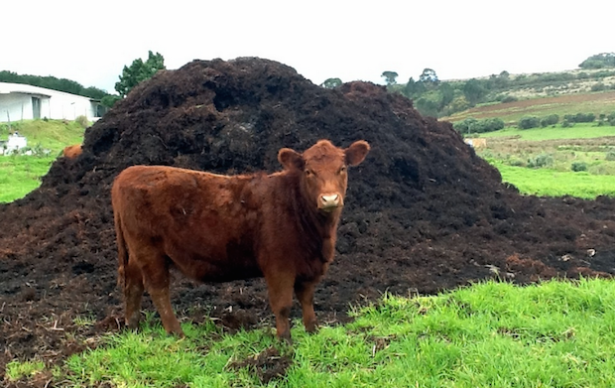
Common feedstocks
Cattle manure
Nitrogen rich, very wet
Requires lots of dry, high-carbon amendment (3:1)
Decomposes quickly
Notes:
Cattle manure is nitrogen-rich and very wet. Because it is so wet, it requires a dry-high carbon amendment to be mixed with it, usually at a rate of two to three volumes of dry matter per volume of manure. It decomposes quickly and is overall a very good compost feedstock.

Slide 13
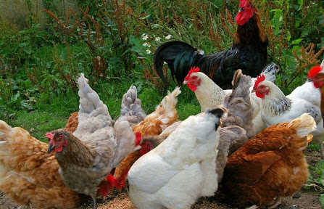
Common feedstocks
Poultry litter
Very high nitrogen content, moderately moist
Nitrogen loss and odor can be issues because of high N and high pH
Decomposes quickly
Notes:
Poultry manure also has a high nitrogen content and needs a high carbon amendment. Litter is often a mixture of waste with sawdust or wood shavings, and this mixture is well-suited for composting. Because it is so high in nitrogen, poultry litter can have issues with odor and nitrogen loss when there isn’t enough carbon in the mix, but it does produce a fertilizer-grade compost and it is another good compost feedstock.

Slide 14
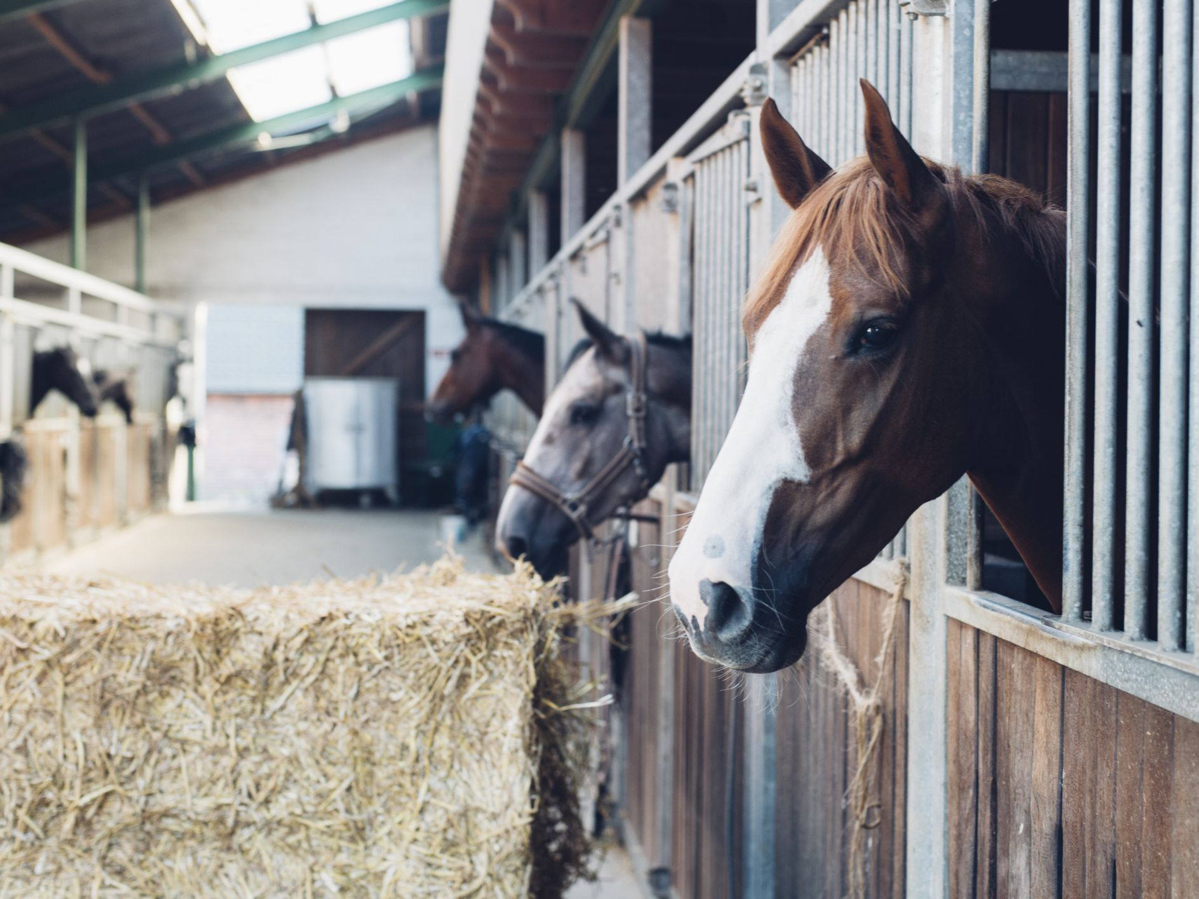
Common feedstocks
Horse manure and horse bedding
Usually includes lots of bedding, making for a drier substance
Decomposes quickly
Often available at little to no-cost
Notes:
Horse manure is an excellent source of composting material and it usually includes bedding mixed with the manure, making a feedstock that is both dry and has a high C:N ratio. It decomposes quickly, especially if the bedding used was straw. It is often available for cheap or for free at local stables, racetracks, or other establishments with horses so it is often readily available if you need an off-farm manure source.

Slide 15
Common feedstocks
Other sources of N
Materials High in Nitrogen | C:N ratio
Vegetable waste | 15-20:1
Coffee grounds | 20:1
Grass clippings | 15-25:1
Manure | 5-25:1

Slide 16
Common feedstocks
Sources of C
Materials High in Carbon | C:N ratio
Straw | 40-100:1
Autumn leaves | 30-80:1
Wood chips and sawdust | 100-500:1
Newspaper and cardboard | 560:1
Notes:
Some common sources of carbon are straw, leaves, wood chips and sawdust, and newspaper or cardboard. Some, like straw and sawdust, will degrade very quickly. Others, like wood chips, have large particle sizes so they are great for structure and porosity but they degrade slowly. Leaves can sometimes be composted alone, but they also make an excellent feedstock.

Slide 17
The Composting Process
Key Variables:
Initial feedstock mix (C:N ratio)
Oxygen and aeration
Pile structure and shape (pile porosity)
Particle size
Moisture
Pile temperature
Time

Slide 18
Oxygen and aeration
The need for oxygen is greatest at early stages and then decrease as the process ages
Less oxygen slower composting process
Without sufficient oxygen, the pile can become anaerobic
Aeration
  removes heat, water vapor, and other trapped gases
Notes:
Oxygen is required for aerobic respiration. Without sufficient oxygen, the materials become anaerobic and anaerobic decomposition involves a different set of microorganism and biochemical processes.
Aeration to the pile can happen mechanically by turning or by using blowers to blow air into the pile. Aeration is important because it supplies additional oxygen to the pile, but it also removes heat that has built up as well as water vapor and other trapped gases that need to be released.

Slide 19
The Composting Process
Key Variables:
Initial feedstock mix (C:N ratio)
Oxygen and aeration
Pile structure and shape (pile porosity)
Particle size
Moisture
Pile temperature
Time

Slide 20
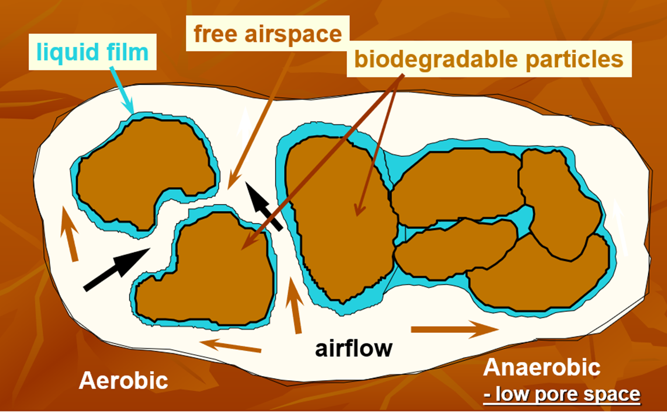
Pile porosity
A measure of the air space within the compost pile and determines resistance to airflow
Determined by:
  Height of the pile
  Particle size
Larger particles and more uniform particles increase porosity
Notes:
Porosity, structure, texture, and particle size all relate to the physical properties of the materials used as compost feedstocks. The porosity is a measure of the air space within the compost pile and it is determined by particle size and height of the pile. Larger particles increase the pile porosity. A pile with lots of free airspace allows for the exchange of oxygen in and carbon dioxide out. When the pore space is low, air is unable to flow freely and this can lead to anaerobic conditions.

Slide 21
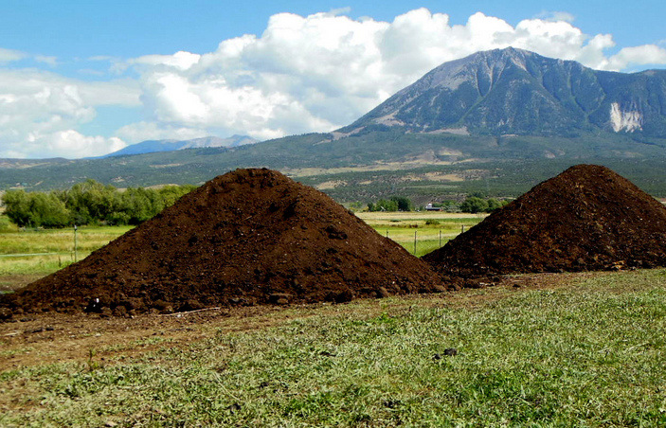
Pile size
Smaller piles allow for greater air flow
Larger piles retain temperatures
Too large compacts bottom of pile
Denser materials should be in smaller piles
  manures, food wastes: smaller, 4-6’ high
  leaves, brush: higher, 6-10’ high
Notes:
Piles that are smaller tend to allow for greater air flow, especially to the center of the pile where heat is being generated. Larger piles tend to retain temperatures better, but piles that are too large can lead to compaction at the bottom of the pile, which reduces porosity and airflow, especially with dense or moist feedstocks. Therefore, denser materials like manure and food wastes should be in small piles and fluffier materials like leaves and brush can be in higher piles.

Slide 22
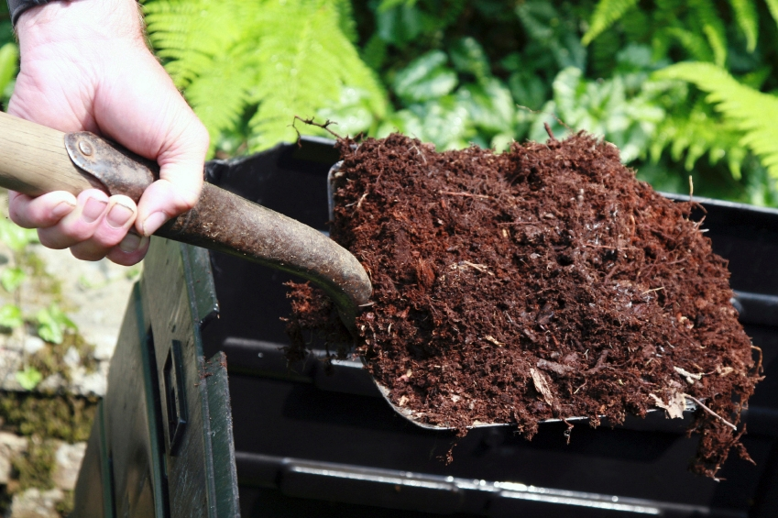
Particle size
Smaller particles have more surface area relative to volume than larger particles
Very fine particles prevent air flow, creating anaerobic conditions
Ideal particle size is 1/8 in. to 2 in.
Notes:
The size of the compost feedstock particles matters not just for porosity, but also because decomposition will happen quicker with smaller particles. However, smaller particles also reduce porosity and can create anaerobic conditions if air flow is blocked, so the best particle size ranges from 1/8 of an inch to 2 inches in average diameter.

Slide 23
The Composting Process
Key Variables:
Initial feedstock mix (C:N ratio)
Oxygen and aeration
Pile structure and shape (pile porosity)
Particle size
Moisture
Pile temperature
Time

Slide 24
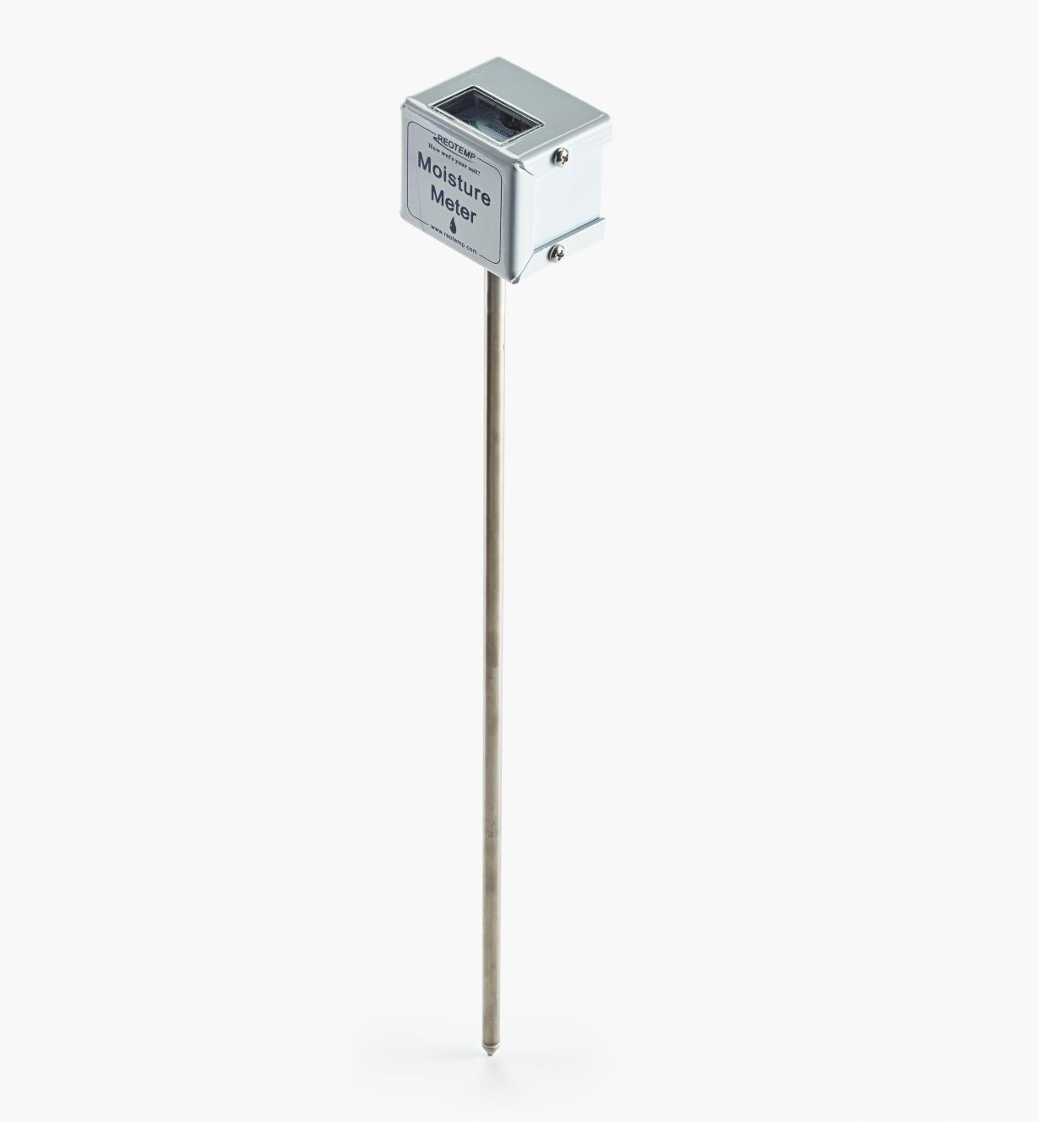
Moisture
Required for biological life processes
Ideal range is 40%-65%
< 40% microbial activity slows
  difficult to re-wet
> 65% means pore spaces filled
  anaerobic conditions
Adding water is difficult
Notes:
Ideally, compost materials should be maintained within a 40%-65% moisture content by weight. Below 40%, microbial activity will slow. At moisture levels above 65%, water displaces air in the pore spaces, which limits air movement and can lead to anaerobic conditions.
A general rule of thumb is compost is too wet if water can be squeezed out of a handful and too dry if it does not feel moist to the touch. Adding water to a dry pile can be difficult. In general, it takes 25 gallons of water per ton to raise the moisture content of a pile approximately 10%!

Slide 25
The Composting Process
Key Variables:
Initial feedstock mix (C:N ratio)
Oxygen and aeration
Pile structure and shape (pile porosity)
Particle size
Moisture
Pile temperature
Time

Slide 26
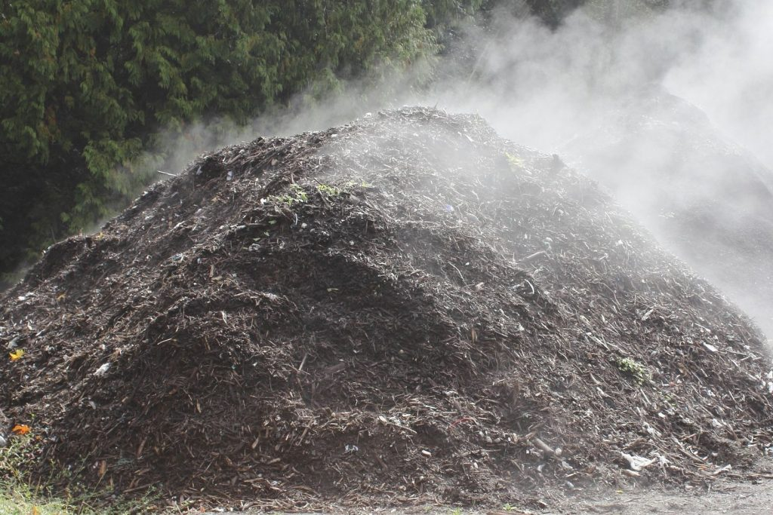
Temperature
Higher temps result in faster breakdown, up to 140ºF
At temps > 160ºF lose microbial diversity, composting processes will slow or stop altogether
Most weeds and pathogens killed at temps >130 (55ºC)
Notes:
As we discussed, mesophilic temperatures are during the initial phases of composting, but thermophilic temperatures are actually the most desirable over time because they destroy potential pathogens in the compost materials. The critical temperature for killing human pathogens and most plant pathogens is 131 degrees F and most weed seeds are destroyed at 145 degrees F. Higher temperatures also result in faster breakdown of materials, although temperatures over 140 degrees will slow microbial activity. At 160 degrees, microbes will begin to die or become dormant, effectively stopping the composting process.

Slide 27
The Composting Process
Key Variables:
Initial feedstock mix (C:N ratio)
Oxygen and aeration
Pile structure and shape (pile porosity)
Particle size
Moisture
Pile temperature
Time

Slide 28
Time
Mesophilic
  a few days to 2 weeks
Thermophilic
  3 weeks to several months
Curing and maturation
  1 to several months
Notes:
As we’ve discussed, there are several variables that will determine the length of time required to transform raw materials into compost. Certain conditions are optimal and certain conditions will slow the process. The mesophilic phase can last from a few days to a few weeks, the thermophlic phase from a few weeks to several months, and usually a 4-8 week period of curing is recommended.

Slide 29
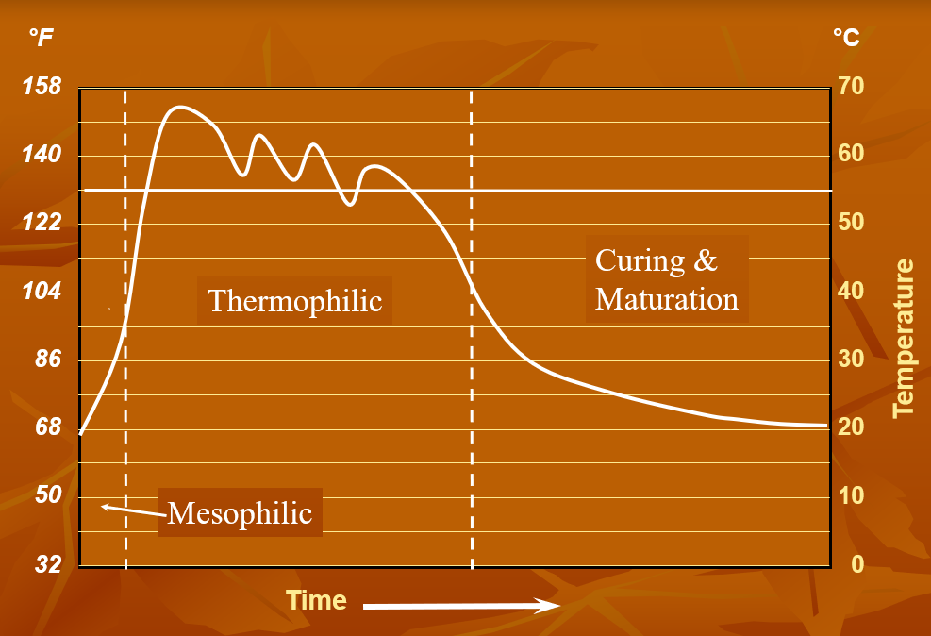

Slide 30
Curing
Occurs at low, mesophilic temperatures
Usually begins after pile temperature shows a steady decrease
Minimum curing time: 1 month
Notes:
Curing is an important step and is sometimes the forgotten stage of composting. Curing occurs at low, mesophilic temperatures and allows the compost to mature. Curing furthers the aerobic decomposition of resistant compounds, large particles, and allows the pH to shift to neutral and the C:N ratio to decrease. The curing phase of composting usually begins after the pile temperature shows a steady decrease or when the temperature no longer reheats after turning. At a minimum, compost should be left in the curing phase for at least 1 month, but longer is typically better.

Slide 31
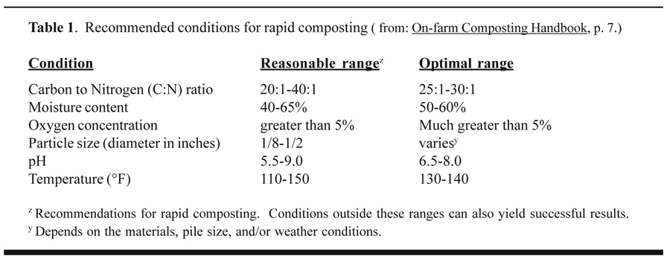
The Composting Process
Notes:
So here is a chart that shows the recommended conditions for rapid composting. As we’ve talked about, the C:N ratio is best between 25:1-30:1

Slide 32
Composting Methods
Passive composting (1-2 years)
  Materials combined to decompose over time with little management
Windrow composting (2-9 months)
  Materials formed into long, narrow piles and turned
Aerated static pile (1 month)
  Blowers force air through pipes into a pile
  No turning
In-vessel composting (1 week)
  Materials contained in bins or other vessels
  Varies from simple aerated bins to elaborate systems

Slide 33
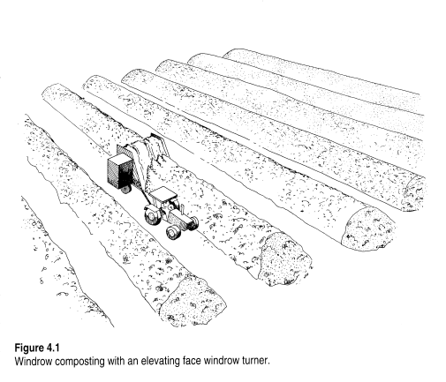
Windrow Composting
3-12 feet high; 10-20 feet wide windrows
Must maintain a turning schedule
More labor intensive than static aerated piles
Common on farm operations
Notes:
Windrow composting creates long narrow piles, or windrows, of raw materials and these piles are turned on a regular basis and monitored for temperature. Turning mixes the materials and releases trapped heat, water vapor, and gases. Turning also exchanges the material at the windrow’s surface with internal materials, and this exposes all material equally to the air, ensuring an even compost. For windrow composting, operators must monitor the piles for temperature and moisture, and it’s a good idea to have a turning schedule to make sure the piles are being properly aerated. This system is more labor intensive than static aerated piles, but they allow a farm to use equipment they may already have on hand, like a tractor with a bucket, to do the turning.

Slide 34
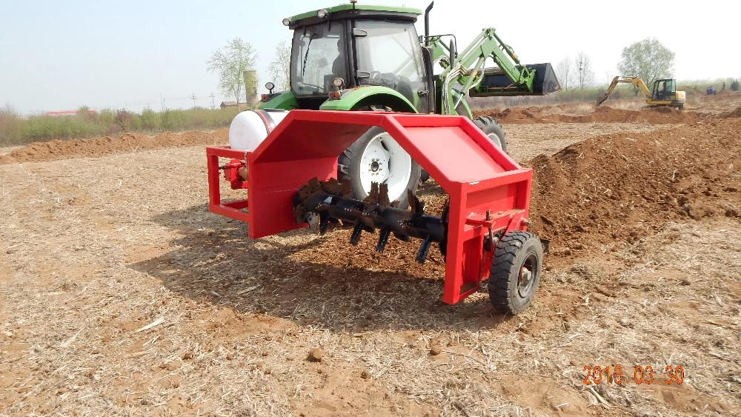
Turning compost piles
Turning Equipment
  Pitchfork
  Bucket loader on a tractor
  PTO-driven compost turners
  Self-driven windrow turners
    Auger turner
    Elevating face turner
Fluffs pile and breaks up particles
Temporarily adds oxygen
  added oxygen consumed within 1 hour in active pile
Notes:
An operation doing windrow composting will likely need equipment that is scaled to the size of the windrows. This can be accomplished on a small to moderate sized operation using the bucket or front end loader of a tractor or for small piles, simply a shovel or several people with pitchforks can turn a pile. There is specialized equipment that can make turning more efficient, including PTO-driven compost turners, like the one you see in this picture. There are also self-driven windrow turners like auger turners and elevating face turners.
Turning the compost pile both fluffs the pile which maintains porosity by reducing compaction that may have developed over time AND breaks up particles into smaller pieces, which reduces porosity if the particles become too small. This additional oxygen introduced by turning is only temporary, as the oxygen is quickly consumed. This is why piles often need to be turned multiple times over the course of the composting process.

Slide 35
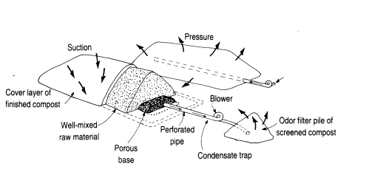
Aerated static pile
Blower supplies air to composting materials
No turning or agitation
Piles must maintain porosity throughout composting process
Easy to automate
Conserves nitrogen better than windrows
Common at sewage sludge facilities
Notes:
An aerated static pile is basically what it sounds like. It is a composting system that used a series of perforated pipes connected to a blower as an air distribution system running under the compost pile. The pile is not turned. If all conditions are righrt, the active composting period can be completed in 3-5 weeks.
Since the pile does not receive additional turnings the initial mix of raw materials is very important. The pile must maintain porosity throughout the entire composting period in order to prevent going into anaerobic decomposition. Manure or other materials must be thoroughly blended with the wood chips in order to promote uniformity in particle size throughout the pile. Because you can set up times for air blowing, this system is easy to automate, unlike windrow composting that requires active turning. Because the pile isn’t being turned, it conserves nitrogen fairly well, However, the system can be finnicky, expensive, and it requires special equipment.

Slide 36
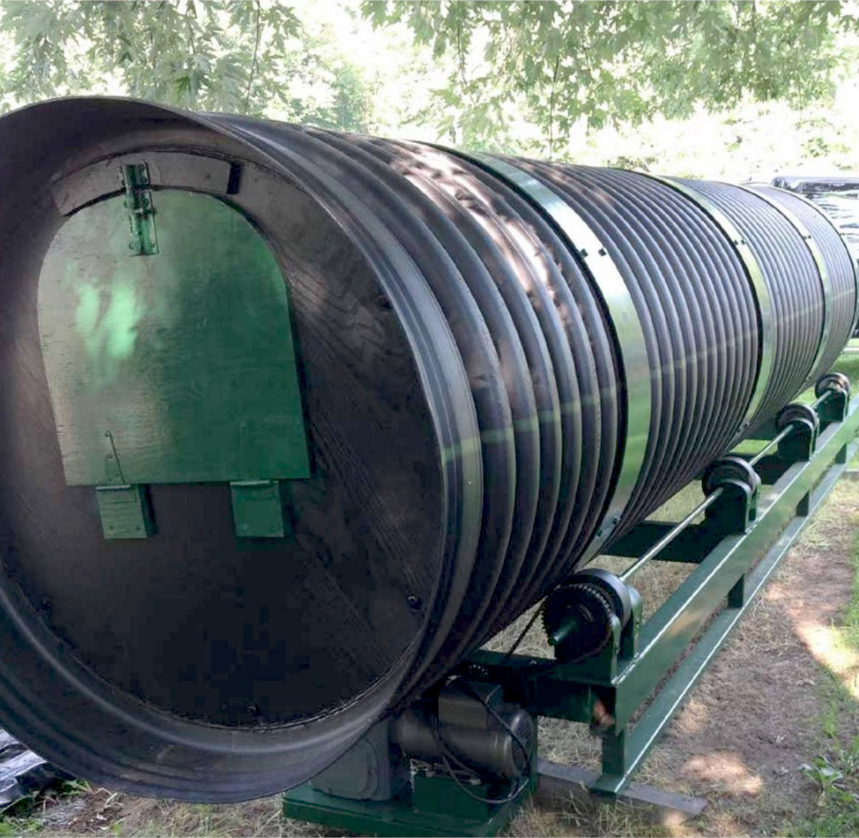
In-vessel composting
Rotating Drums
4-5 feet diameter, 8-16 feet long or more
Load feedstocks at one end and remove compost from other end
Aeration passive or forced
Can be automated
Composts in 3 weeks or less
Notes:
In-vessel composting encompasses several methods of composting that confine the materials within a container or vessel. They can rely on both forced aeration and mechanical turning and often borrow techniques from windrow and static aerated composting. I’m just going to point out one method here, because it is a system we see sometimes that seems to work pretty well and it can be relatively easy to set up. Rotating drums feature a long horizontal drum that is constantly turned to aerate the mix. Feedstocks are loaded at one end and removed from the other as the compost is finished. The turning can be automated and the aeration can include forced air. This method yields a quick compost, sometimes in less than 3 weeks.

Slide 37
USDA-National Organic Program
NOP regulation 7 CFR 205.203(c):
The producer must manage plant and animal materials to maintain or improve soil organic matter content in a manner that does not contribute to contamination of crops, soil, or water by plant nutrients, pathogenic organics, heavy metals, or residues of prohibited substances. Animal and plant materials includes:
(2) Composted plant and animal materials produced through a process that:
(i) Established an initial C:N ratio of between 25:1 and 40:1; and
(ii) Maintained a temperature of between 131°F and 170°F for 3 days using an in-vessel or static aerated pile system; or
(iii) Maintained a temperature of between 131°F and 170°F for 15 days using a windrow composting system, during which period, the materials must be turned a minimum of five times.
Notes:
The NOP regulation 7 CFR 205.203(c), the soil fertility and crop nutrient management practice standard, provides requirements for documentation needed for compost production using an in-vessel or static aerated pile system, and for a windrow systems. As you can see here in the language of the regulation, a static aerated pile needs to be at least maintained between 131 and 170 degrees for 3 days and a windrow compost must be maintained between 131 and 170 degrees for 15 days and turned a minimum of 5 times. We require documentation that demonstrates these measures have been taken before we can approve a compost for use in organic production.

Slide 38
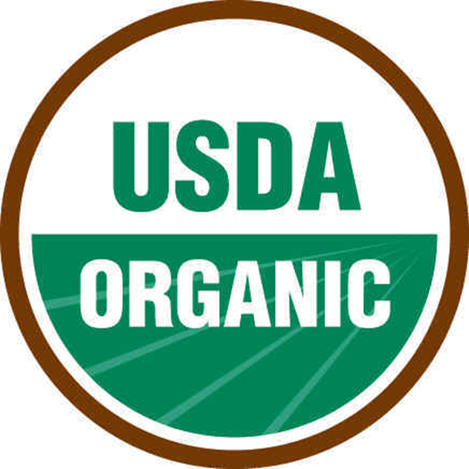
USDA-National Organic Program
NOP Guidance 5021
Other examples of acceptable composting methods include:
Compost that is made from allowed feedstock materials (either nonsynthetic substances not prohibited at § 205.602, or synthetics approved for use as plant or soil amendments), and
The compost pile is mixed or managed to ensure that all of the feedstock heats to the minimum of 131 F (55 C) for a minimum of three days. The monitoring of the above parameters must be documented in the OSP in accordance with § 205.203(c) and verified during the site visit.
Notes:
In 2011, the NOP released a Guidance document, NOP 5021, that elaborates on other acceptable composting methods for organic production. This document states that any compost made from approved plant and animal materials and managed or mixed to ensure that all feedstocks heat to a minimum of 131°F for a minimum of 3 days can be approved. While different certifiers may interpret this rule differently, QCS policy also requires growers to submit pathogen tests when they are using composting methods different from those outlined at 205.203. Compost that does not meet these guidelines and contains manure as a feedstock is treated like raw manure and requires a time restriction from the date of application to the date of harvest.

Slide 39
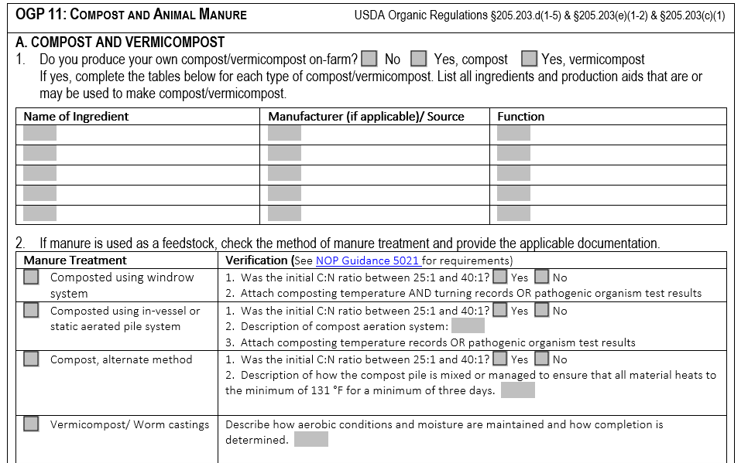

Slide 40
Compost Resources
On-Farm Composting Handbook https://ecommons.cornell.edu/handle/1813/67142
Field Guide to On-Farm Composting https://ecommons.cornell.edu/handle/1813/67148
U.S. Composting Council http://www.compostingcouncil.org
Cornell University Composting http://compost.css.cornell.edu/index.html

